Slide 1
OpenMTR
Matt Clinard, Bryan Dingman, Alan Carpenter, Todd Reagan, & Nick Hietala

Slide 2
What is OpenMTR?
OpenMTR is a .NET framework console application that utilizes Optical Character Recognition to read water and gas meters.
Technologies used
OpenCV
OpenCVSharp
Newtonsoft JSON.NET

Slide 3
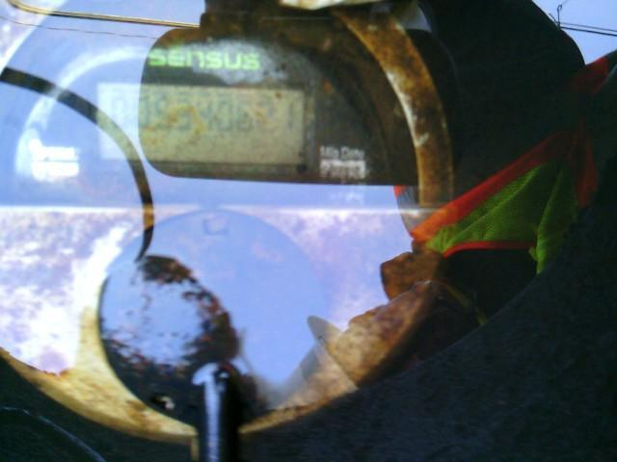
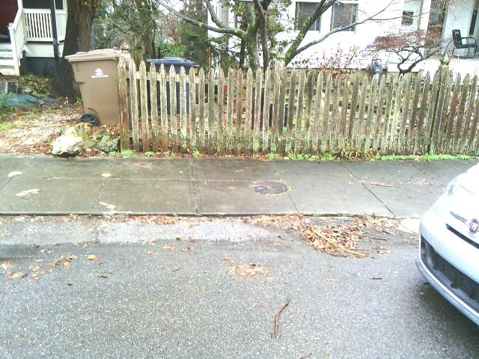
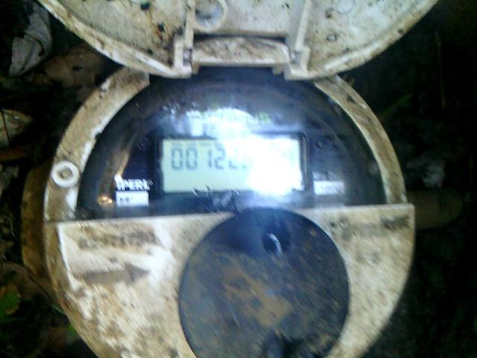
Challenges
Challenges
Pictures are not perfect
Glare
Dirt
Objects in the way
No meter at all
Hang on, lemme take a selfie
Thanks sun.
I spy with my little eye...

Slide 4
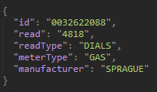
How OpenCV and OpenMTR handles data
Data Mat-ters
All images are stored in Mat data type
Mat objects are n-dimensional dense numerical single-channel or multi-channel arrays
All of our images are read in as a multi-channel Mat
Most filters require a single-channel Mat, so before we do any processing, we convert to grayscale
OpenMTR Meter
We store all of the read images in a Meter object
Meter is comprised of four attributes
Filename <string>
Source Image <Mat>
Modified Image <Mat>
MetaData <MeterMetaData>
Read Process
Read in image file and metadata; Convert into Meter object
Based on metadata, process as Digital or Dial meter
JSON Metadata

Slide 5
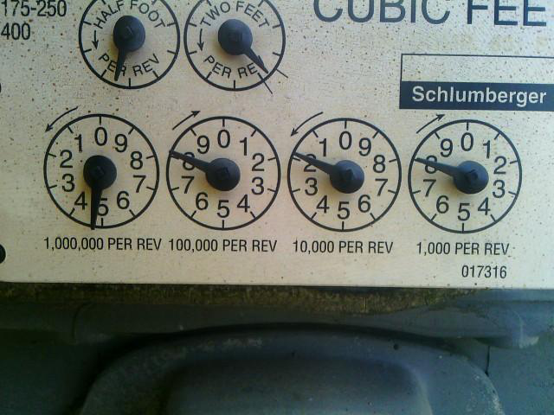
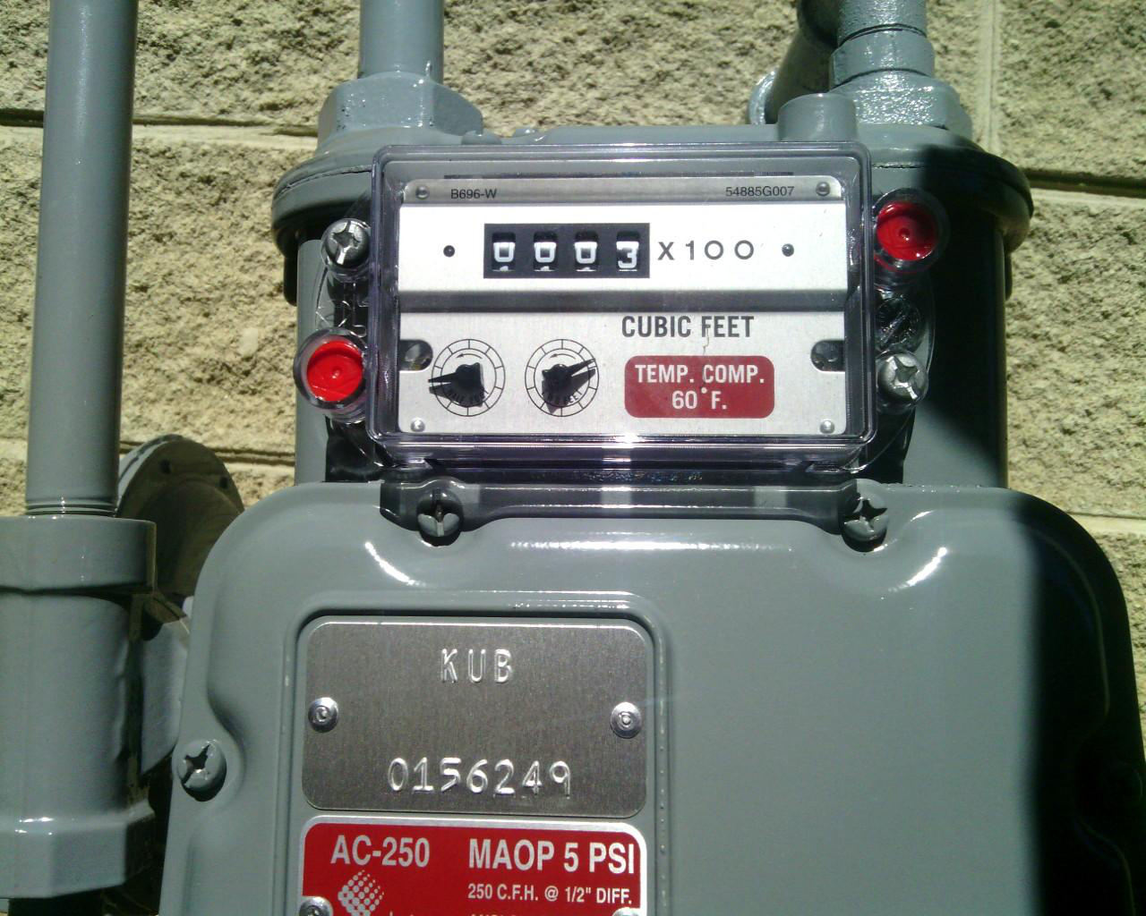
Types of meters
Dial meters Digital/Odometer meters

Slide 6
Reading a dial meter

Slide 7
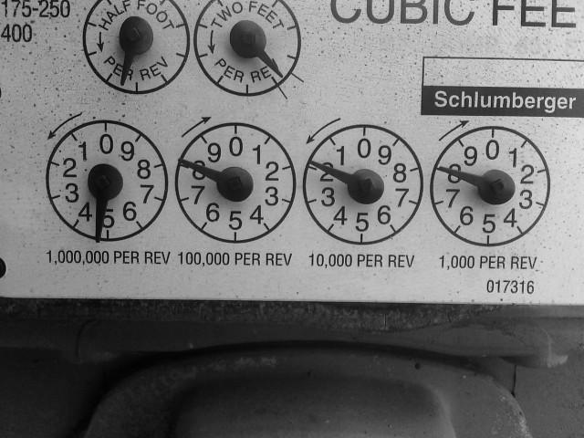

Read process for dial
Convert source image to grayscale
Apply filters from OpenCV to clean up and highlight the data we want
For a dial meter, we applied a morphological operation to remove background noise
Source image
Grayscale image
Image with filters

Slide 8
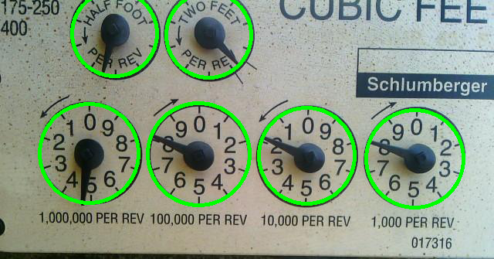
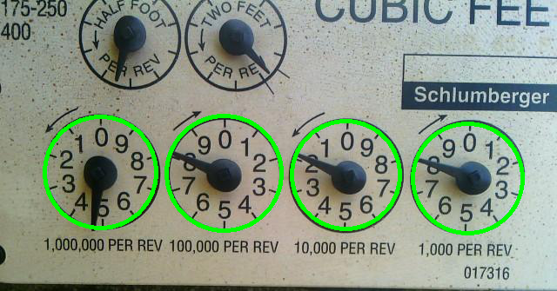
Read process for dial meter
Using Hough Circles, find all circles in the image
Filter the circles based on Y axis of the center point and then sort left to right
Source image with circles drawn
Source image with filtered circles drawn

Slide 9
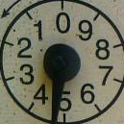
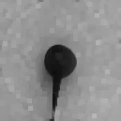

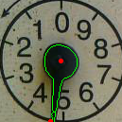
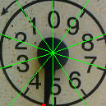
Read process for dial meter
Extract the dials from the source picture
Extracting the digit
Apply gray filter and adjust skew to straighten up image
“Dilate” the image to remove the background
Apply “Canny” filter to edge detect the needle and get the contours
Find farthest point from center
Break the dial up into 10 quadrants and detect which quadrant the tip of the needle is in
Source image
Dilated filter
Canny filter
Contours, center, and needle tip
Quadrants and needle tip

Slide 10
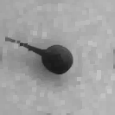
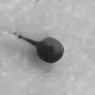
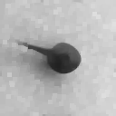
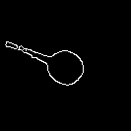
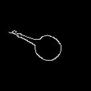
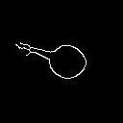
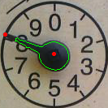
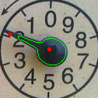
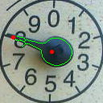
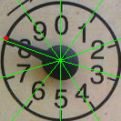
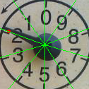
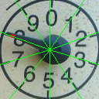
Read Complete!
Compare read value to metadata
Correct values are ignored
Incorrect values are reported
JSON Metadata
4
8
1
8

Slide 11
Reading an odometer

Slide 12
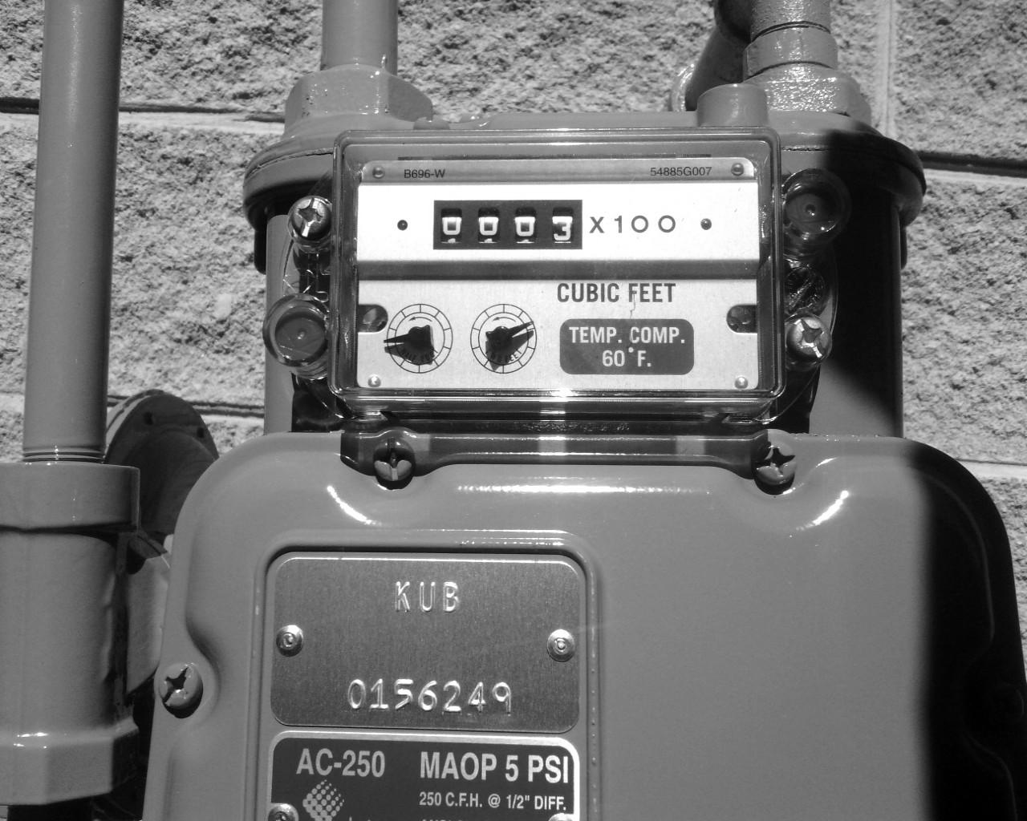
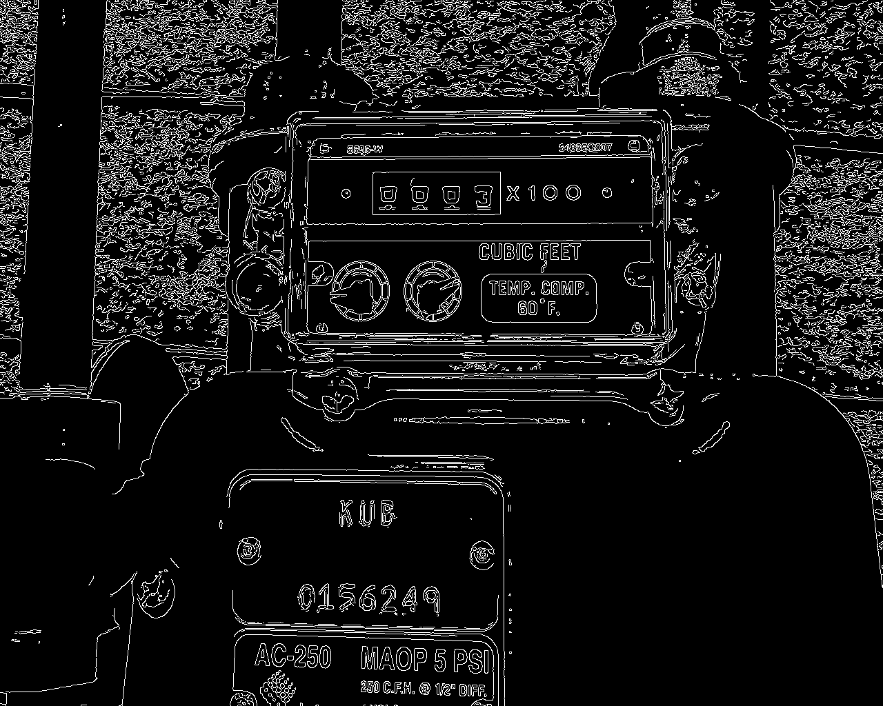
Read process for Odometer
Convert source to gray
Apply “Canny” filter for edge detection
Source image
Grayscale image
Canny filter

Slide 13
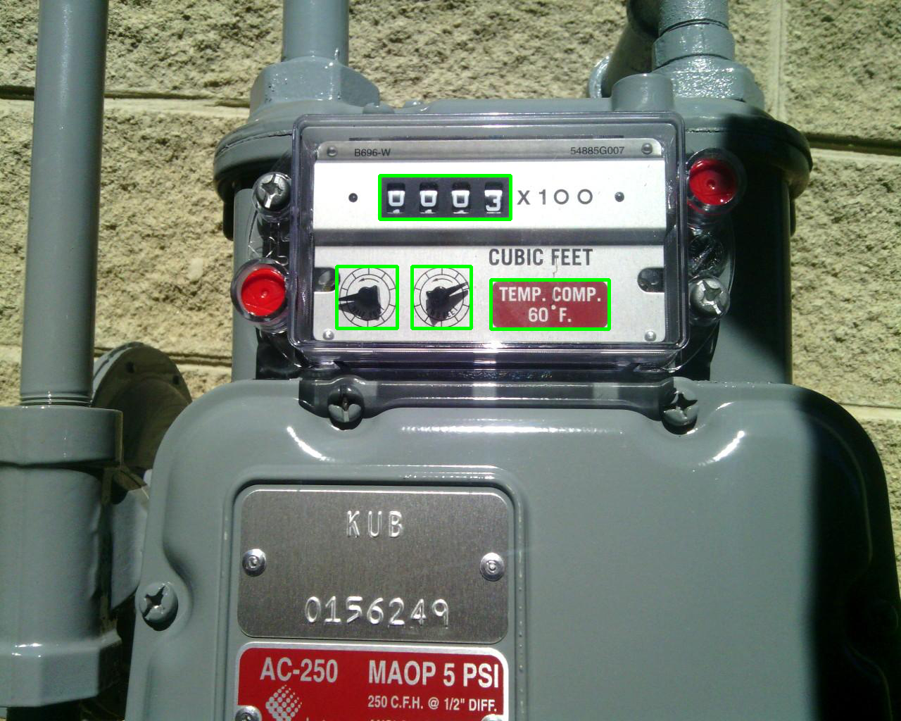

Read process for Odometer
Find the contours in the image and draw the largest rectangles
Filter out readout based on area
Largest rectangles selected
Filtered rectangle

Slide 14
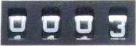
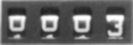


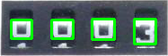
Read process for Odometer
Extract the readout from the source image
Turn to grayscale and blur the image
Apply an adaptive threshold filter to remove data
Apply Morphological filter to clean up the background noise
Find the contours and extract the digits by their area
Extracted source image
Grayscale and blurred
Adaptive threshold filter
Morphological filter
Extracted digits selected

Slide 15
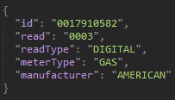
Read process for Odometer
1
2
3
Extract the digit from the modified image
Apply another Morphological filter to close up gaps
Segment the image into 7 segments
Based on how “full” the segment is determines if it’s ON or OFF
Using a lookup table, translate the ON/OFF states to a number
Compare read value to metadata
Correct values are ignored
Incorrect values are reported
4
5
6
7
Segments
JSON Metadata
0
0
0
3

Slide 16
What’s next?
Read “bad” images and adjust our workflow
Iterating over multiple images vs just select ones
Improving both read processes
Implementing machine learning for odometer reads

Slide 17
Questions?

